Slide 1
COM521 Ethical Hacking and Pen testing – Labs
CEH v12 Session Hijacking

Slide 2
Session Hijacking
Session hijacking allows an attacker to take over an active session by bypassing the authentication process. It involves stealing or guessing a victim’s valid session ID, which the server uses to identify authenticated users, and using it to establish a connection with the server. The server responds to the attacker’s requests as though it were communicating with an authenticated user, after which the attacker is able to perform any action on that system.
Attackers can use session hijacking to launch various kinds of attacks such as man-in-the-middle (MITM) and Denial-of-Service (DoS) attacks. A MITM attack occurs when an attacker places himself/herself between the authorized client and the server to intercept information flowing in either direction. A DoS attack happens when attackers sniff sensitive information and use it to make host or network resource unavailable to users, usually by flooding the target with requests until the system is overloaded.
As a professional ethical hacker or penetration tester, you must possess the required knowledge to hijack sessions in order to test the systems in the target network.
Notes:
Session hijacking allows an attacker to take over an active session by bypassing the authentication process. It involves stealing or guessing a victim’s valid session ID, which the server uses to identify authenticated users, and using it to establish a connection with the server. The server responds to the attacker’s requests as though it were communicating with an authenticated user, after which the attacker is able to perform any action on that system.
Attackers can use session hijacking to launch various kinds of attacks such as man-in-the-middle (MITM) and Denial-of-Service (DoS) attacks. A MITM attack occurs when an attacker places himself/herself between the authorized client and the server to intercept information flowing in either direction. A DoS attack happens when attackers sniff sensitive information and use it to make host or network resource unavailable to users, usually by flooding the target with requests until the system is overloaded.
As a professional ethical hacker or penetration tester, you must possess the required knowledge to hijack sessions in order to test the systems in the target network.

Slide 3
Overview of Session Hijacking
Overview of Session Hijacking
Session hijacking can be divided into three broad phases:
Tracking the Connection: The attacker uses a network sniffer to track a victim and host, or uses a tool such as Nmap to scan the network for a target with a TCP sequence that is easy to predict
Desynchronizing the Connection: A desynchronized state occurs when a connection between the target and host has been established, or is stable with no data transmission, or when the server’s sequence number is not equal to the client’s acknowledgment number (or vice versa)
Injecting the Attacker’s Packet: Once the attacker has interrupted the connection between the server and target, they can either inject data into the network or actively participate as the man-in-the-middle, passing data between the target and server, while reading and injecting data at will
Notes:
Overview of Session Hijacking
Session hijacking can be divided into three broad phases:
Tracking the Connection: The attacker uses a network sniffer to track a victim and host, or uses a tool such as Nmap to scan the network for a target with a TCP sequence that is easy to predict
Desynchronizing the Connection: A desynchronized state occurs when a connection between the target and host has been established, or is stable with no data transmission, or when the server’s sequence number is not equal to the client’s acknowledgment number (or vice versa)
Injecting the Attacker’s Packet: Once the attacker has interrupted the connection between the server and target, they can either inject data into the network or actively participate as the man-in-the-middle, passing data between the target and server, while reading and injecting data at will

Slide 4
Activities: Perform Session Hijacking
(Expected Duration 1 hours, 20 minutes)
Hijack a session using Zed Attack Proxy (ZAP)
Intercept HTTP traffic using bettercap
Intercept HTTP traffic using Hetty
Notes:
Hijack a session using Zed Attack Proxy (ZAP)
Intercept HTTP traffic using bettercap
Intercept HTTP traffic using Hetty

Slide 5

Zed Attack Proxy (ZAP)
Zed Attack Proxy (ZAP) is an integrated penetration testing tool for finding vulnerabilities in web applications. It offers automated scanners as well as a set of tools that allow you to find security vulnerabilities manually. It is designed to be used by people with a wide range of security experience, and as such is ideal for developers and functional testers who are new to penetration testing.
Notes:
Zed Attack Proxy (ZAP) is an integrated penetration testing tool for finding vulnerabilities in web applications. It offers automated scanners as well as a set of tools that allow you to find security vulnerabilities manually. It is designed to be used by people with a wide range of security experience, and as such is ideal for developers and functional testers who are new to penetration testing.
ZAP allows you to see all the requests you make to a web app and all the responses you receive from it. Among other things, it allows you to see AJAX calls that may not otherwise be outright visible. You can also set breakpoints, which allow you to change the requests and responses in real-time.
Here, we will hijack a session using ZAP. You will learn how to intercept the traffic of victims’ machines with a proxy and how to view all the requests and responses from them.

Slide 6
Tasks
Configure the proxy settings in the victim’s machine, which in this task will be the Windows 11 machine
Run ZAP proxy in Windows 2019
Click on the “+” icon in the right pane and select Break from the options.
The Break tab allows you to modify a response or request when ZAP has caught it. It also allows you to modify certain elements that you cannot modify through your browser, including:
The header
Hidden fields
Disabled fields
Fields that use JavaScript to filter out illegal characters

Slide 7
Tasks (Continued)
Set break on all requests and responses icon on the main ZAP toolbar. This button sets and unsets a global breakpoint that will trap and display the next response or request from the victim’s machine in the Break tab.
Open webpage on the victim machine
in the Break tab, modify www.moviescope.com to www.goodshopping.com in all the captured GET requests.
modify every GET request captured by OWASP ZAP until you see the www.goodshopping.com page in the victim’s machine.

Slide 8
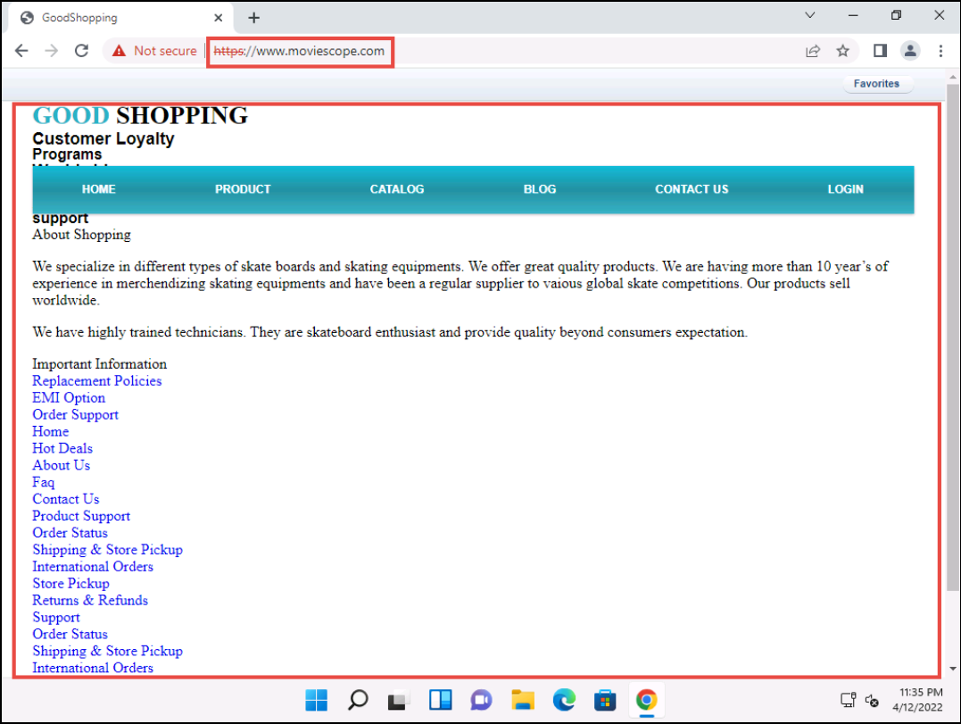
Task Conclusions: Proxy Redirect
The victim has navigated to www.moviescope.com, but now sees www.goodshopping.com; while the address bar displays www. moviescope.com, the window displays www.goodshopping.com.
Reflection Question :
"How does modifying HTTP requests and responses in ZAP enhance your understanding of web security, and why is it important to handle such capabilities responsibly?"
Notes:
Using the Zed Attack Proxy (ZAP) to modify HTTP requests and responses has significantly enhanced the individual's understanding of web security, particularly in the way data is exchanged between clients and servers and how vulnerable these interactions can be to manipulation. By intercepting and altering requests, they have gained insight into how attackers could exploit web applications. For instance, changing GET requests to redirect users from a legitimate site to a malicious one illustrates how easily users can be misled, emphasizing the importance of secure coding practices and comprehensive security testing in web development.
Furthermore, this experience highlighted the ethical responsibilities tied to possessing such capabilities. While these skills are valuable for identifying vulnerabilities and strengthening application security, they can also be misused. It is crucial to approach these activities with a sense of legal and ethical duty, ensuring that penetration testing is conducted with proper authorization and with the intent of improving security, not causing harm.
In summary, by using ZAP to modify HTTP requests and responses, the individual not only gained technical knowledge about security vulnerabilities but also developed a deeper appreciation for the ethical implications of such actions. It serves as a reminder that the ability to manipulate web traffic must be used responsibly and within legal boundaries."
This version maintains a reflective tone while keeping the focus on the individual's learning and ethical considerations, expressed in the third person.

Slide 9
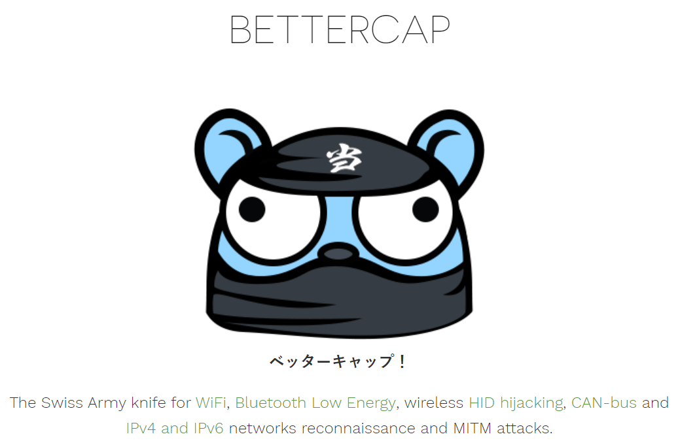
Task 2: Intercept HTTP Traffic using bettercap
Attackers can use session hijacking to launch various kinds of attacks such as man-in-the middle (MITM) attacks. In an MITM attack, the attacker places himself/herself between the authorized client and the webserver so that all information traveling in either direction passes through them.
An ethical hacker or a penetration tester, you must know how MITM attacks work, so that you can protect your organization’s sensitive information from them. bettercap is a powerful, flexible, and portable tool created to perform various types of MITM attacks against a network; manipulate HTTP, HTTPS, and TCP traffic in real-time; sniff for credentials; etc.
Notes:
Attackers can use session hijacking to launch various kinds of attacks such as man-in-the middle (MITM) attacks. In an MITM attack, the attacker places himself/herself between the authorized client and the webserver so that all information traveling in either direction passes through them.
An ethical hacker or a penetration tester, you must know how MITM attacks work, so that you can protect your organization’s sensitive information from them. bettercap is a powerful, flexible, and portable tool created to perform various types of MITM attacks against a network; manipulate HTTP, HTTPS, and TCP traffic in real-time; sniff for credentials; etc.

Slide 10
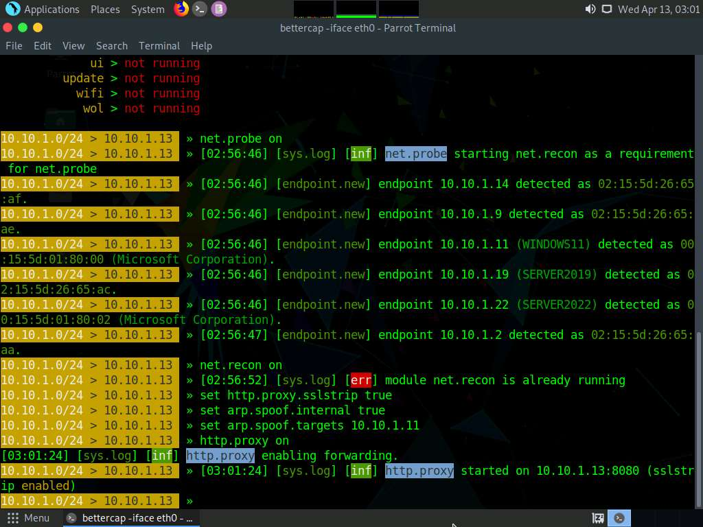
Bettercap
Configure BetterCap interface - bettercap -iface eth0
Enable the following modules:
net.probe on
net.recon on
set http.proxy.sslstrip true This module enables SSL stripping.
set arp.spoof.internal true
set arp.spoof.targets 10.10.1.11
http.proxy on and press Enter. This module initiates http proxy.
arp.spoof on and press Enter. This module initiates ARP spoofing.
net.sniff on and press Enter. This module is responsible for performing sniffing on the network.
set net.sniff.regexp ‘.*password=.+’ and press Enter. This module will only consider the packets sent with a payload matching the given regular expression (in this case, ‘.*password=.+’).
Notes:
net.probe This module will send different types of probe packets to each IP in the current subnet for the net.recon
net.recon module displays the detected active IP addresses in the network. In real-time, this module will start sniffing network packets.module to detect them.
arp.spoof.internal true This module spoofs the local connections among computers of the internal network.
set arp.spoof.targets 10.10.1.11 This module spoofs the IP address of the target host.
http.proxy on This module initiates http proxy.
arp.spoof on This module initiates ARP spoofing.
net.sniff on This module is responsible for performing sniffing on the network.
set net.sniff.regexp ‘.*password=.+’ and press Enter. This module will only consider the packets sent with a payload matching the given regular expression (in this case, ‘.*password=.+’).

Slide 11
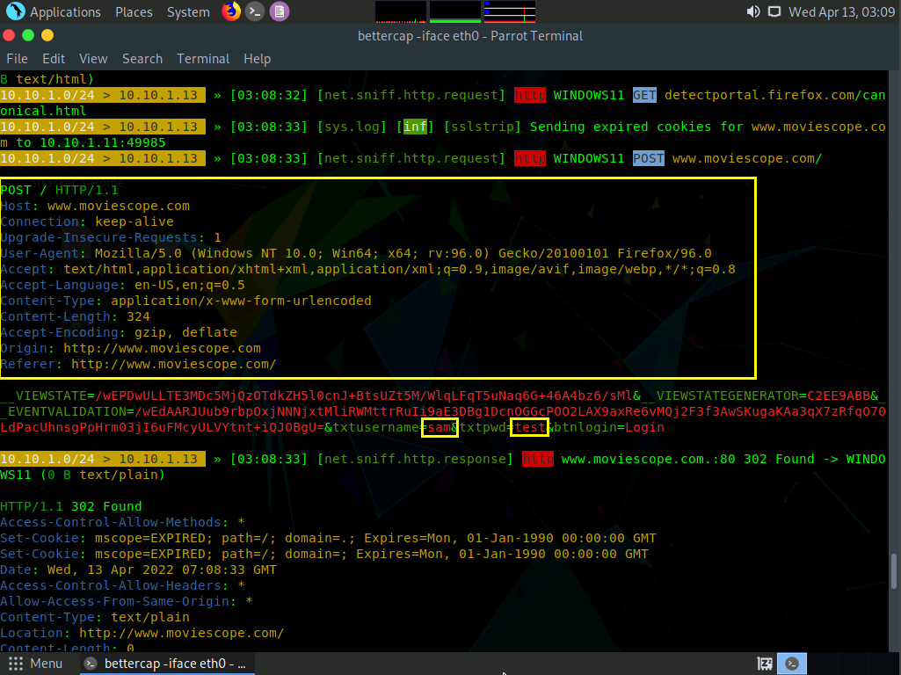
Results
bettercap collects all http logins used by routers, servers, and websites that do not have SSL enabled. In this task, we are using www.moviescope.com for demonstration purposes, as it is http-based. To use bettercap to sniff network traffic from https-based websites, you must enable the SSL strip module by issuing the command set http.proxy.sslstrip true.
This concludes the demonstration of how to intercept HTTP traffic using bettercap.
Reflection Question : How does using Bettercap to sniff HTTP traffic and capture unencrypted data, such as passwords, highlight the vulnerabilities of websites not properly enforcing strict HTTPS policies, such as HTTP Strict Transport Security (HSTS). , and why is it critical for web applications to implement proper encryption protocols?
Notes:
bettercap collects all http logins used by routers, servers, and websites that do not have SSL enabled. In this task, we are using www.moviescope.com for demonstration purposes, as it is http-based. To use bettercap to sniff network traffic from https-based websites, you must enable the SSL strip module by issuing the command set http.proxy.sslstrip true.
SSL stripping is a type of man-in-the-middle (MITM) attack that downgrades a secure HTTPS connection to an insecure HTTP connection. It exploits the process by which a website transitions from HTTP to HTTPS, allowing an attacker to intercept and manipulate the communication between a user and a website.
Here’s how it typically works:
User Request: A user attempts to connect to a website using an HTTPS connection.
Attacker Interception: The attacker, using tools like Bettercap, intercepts this request and prevents the user from upgrading the connection to HTTPS.
HTTP Downgrade: The attacker sends the user a downgraded version of the website over an unencrypted HTTP connection instead of the secure HTTPS.
Data Interception: Since the connection is now in plain text (HTTP), the attacker can view, modify, or steal sensitive data like usernames, passwords, and other personal information transmitted by the user.
This attack is effective against websites that are not properly enforcing strict HTTPS policies, such as HTTP Strict Transport Security (HSTS). SSL stripping shows how vulnerable unencrypted connections are and emphasizes the importance of ensuring websites always use HTTPS to protect sensitive data.
How does using Bettercap to sniff HTTP traffic and capture unencrypted data, such as passwords, highlight the vulnerabilities of websites not properly enforcing strict HTTPS policies, such as HTTP Strict Transport Security (HSTS). , and why is it critical for web applications to implement proper encryption protocols?

Slide 12

Task 3: Intercept HTTP Traffic using Hetty
Task 3: Intercept HTTP Traffic using Hetty
Features
Machine-in-the-middle (MITM) HTTP proxy, with logs and advanced search
HTTP client for manually creating/editing requests, and replay proxied requests
Intercept requests and responses for manual review (edit, send/receive, cancel)
Scope support, to help keep work organized
Easy-to-use web based admin interface
Project based database storage, to help keep work organized
Notes:
Hetty is an HTTP toolkit for security research. It aims to become an open-source alternative to commercial software such as Burp Suite Pro, with powerful features tailored to the needs of the InfoSec and bug bounty communities. Hetty can be used to perform Machine-in-the-middle (MITM) attack, manually create/edit requests, and replay proxied requests for HTTP clients and further intercept requests and responses for manual review.
Here, we will use the Hetty tool to intercept HTTP traffic on the target system.

Slide 13
Tasks
Create a project called moviescope in Hetty
Reconfigure the proxy settings in the victims machine to send requests to the attackers machine with Hetty running
A users credentials can be captured in Hetty proxy logs

Slide 14
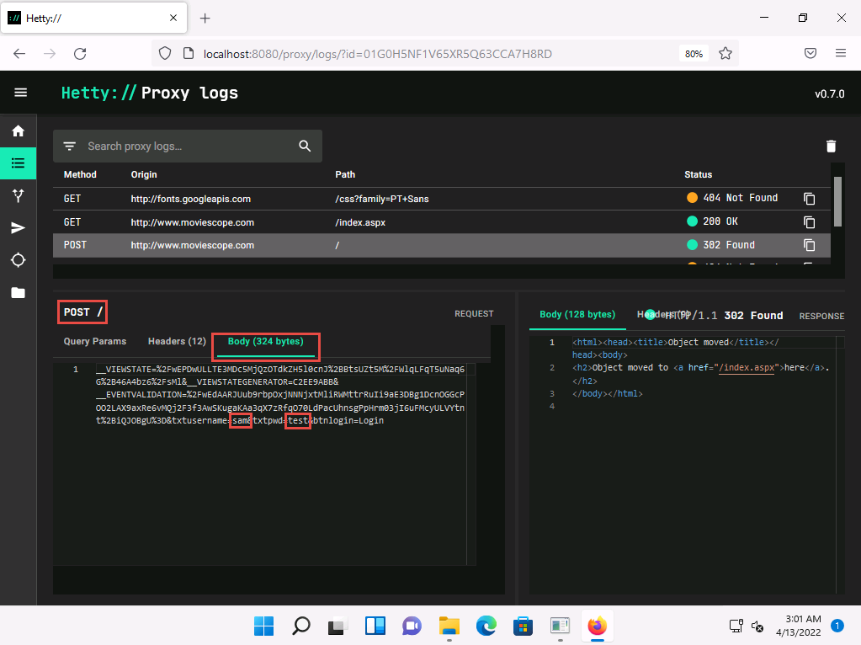
Obtaining the Results
Select the POST request and in the lower section of the page, select Body tab under POST section.
Under the Body tab, you can observe the captured user credentials, as shown in the screenshot.
Conclusion:
The captured credentials can be used to log in to the target user’s account and obtain further sensitive information.
Reflection
What are the ethical implications of intercepting and using captured credentials during a security assessment, and how does this task influence your understanding of personal data protection in web applications?
Notes:
This question encourages a deeper consideration of ethical conduct in security testing and the importance of protecting personal information in the context of real-world web vulnerabilities.
"Intercepting and using captured credentials during security assessments highlights the significant ethical responsibilities held by cybersecurity professionals. This task illustrates the ease with which sensitive data can be intercepted, emphasizing the critical need for robust security measures in web applications. Ethically, it underscores the necessity for security researchers to operate within legal boundaries and with explicit permission from system owners. This practice is not only a legal requirement but also a moral obligation to ensure that their skills do not harm users or exploit systems beyond the scope of improving security.
Furthermore, this task has reinforced their understanding of the importance of personal data protection in web applications. It serves as a real-world example of potential vulnerabilities that can be exploited and the consequences of insufficient security practices. By engaging in such activities in a controlled and ethical manner, they are better prepared to implement stronger security measures and advocate for privacy by design, ensuring that user data is protected against similar attacks in the future."

